Slide 1

1. Handling hardware interrupts in rust. `

Slide 2


Handling Hardware interrupts in rust.
What is an interrupt ?
An interrupt is a signal sent by a device connected to a computer or by a software running on the computer saying that operating system to temporarily pause what it’s doing currently and focus to the interrupt that has being send by the hardware or by software.
In today almost each and all computing systems are interrupt-driven.
We can mainly divide interrupts into two main categories.
1. Hardware interrupts.
2. Software interrupts.

Slide 3
Handling Hardware interrupts in rust.
1. Software interrupts.
A software interrupt occurs when an application program terminates or requests certain services from the OS. Software interrupts also referred as trap or exception
For example,
when fork() system call in Linux called it would generate a software interrupt to create a new process
2. Hardware interrupts.
A hardware interrupt is an electronic signal from an external hardware device that indicates it needs attention from the OS
For example,
moving a mouse or pressing a keyboard key. In these examples of interrupts, the processor must stop to read the mouse position or keystroke at that instant.

Slide 4
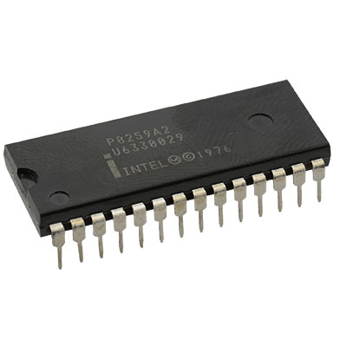
Handling Hardware interrupts in rust.
Intel 8259 Programmable interrupt controller (PIC)
As we know all the hardware devices directly cannot be connected to the CPU. To connect to CPU, we must use interrupt controller.
A programmable interrupt controller (PIC) is an integrated circuit that helps a microprocessor (or CPU) in handling interrupt requests (IRQ) from various sources (such as external I/O devices) that may occur repeatedly

Slide 5
Handling Hardware interrupts in rust.
Steps of creating a hardware interrupt handler in rust.
In order to create a hardware interrupt handler, we can follow up 3 steps and can achieve that.
1 . Reconfiguring the PIC.
2 . Enabling interrupts.
3 . Ending interrupts.

Slide 6
Handling Hardware interrupts in rust.
1. Reconfiguring the PIC
The PICs' default setup is unusable because it transmits interrupt vector numbers ranging from 0 to 15 to the CPU.
2. Enabling interrupts.
To enable external interrupts can use the interrupts::enable function. With enabling the interrupts and while trying to execute the code segment it will show up some errors like double fault occurs.
3. Ending interrupts.
we must have to explicitly say the PIC that interrupt was served, and the system is ready to receive the next interrupt. To notify the PIC that the interrupt was served successfully can use the notify_end_of_interrupt command.

Slide 7
Handling Hardware interrupts in rust.
Handling deadlocks & race conditions.
As we know interrupts will occur asynchronously. Due to it asynchronous interrupts it could lead errors like deadlock situation and race conditions.
In rust language it supports preventing many types of concurrency related bugs at the compile time itself. To avoid deadlocks in system we can simply disable interrupts if the Mutex is locked in system
In rust language can use Without_interrrupts function to ensure that the no interrupts happens while Mutex is locked.

Slide 8
1. Introduction to paging. `

Slide 9
Introduction to paging.
What is paging and why is ?
Paging also a very common technique that used in memory management of the operating system in order to improve the memory.
Ways of memory management.
1. Segmentation.
2. Paging.

Slide 10
Introduction to paging.
1. Segmentation.
The functional behind the segmentation is it will divide the memory to variable size parts and each part named as a segment.
For example, there are segments called code segment (CS) to store codes of the programs, Stack segment (SS) for stack operations, Data segment (DS / ES) to store other instructions and FS , GS segments that can be used to any purpose.
2. Paging.
The simple idea of paging is divided both virtual memory and physical memory into small fixed sized blocks.
The block of virtual memory is called as page and the block of physical address are called as frame.

Slide 11
3. Paging implementation. `

Slide 12
Paging implementation.
In most of case kernel of the operating system runs on virtual address. But if we run the kernel on the virtual address, we will be having some issues like couldn’t access the paging table.
There are 3 steps to follow when implementing paging in operating system.
1. Bootloader support
2. Accessing page tables.
3. Translating addresses.

Slide 13
Paging implementation.
1. Bootloader support.
To enable bootloader support simply we can use the map_Physical_memory function to the bootloader and then we are done
2. Accessing the page table.
Now we all must do is create a function that returns all the references of active level 4-page table.
To do that we can use active_level_4_table function.
3. Translating the addresses.
To do this translation we can use a function called translate_addr_inner.
this function will start reading physical address of corresponded mapped frame and will
it to a physical address.
But the problem is this translate_addr function only support for small size of page tables.
To allow huge page tables addresses to be converted we can use offset page table as a solution

